Slide 1


Slide 1
Android WiFi
Alaa Mohammed Shaban

Slide 2




Slide 5
محاور العرض
Android - Wi-Fi package
Method & Description
Example and Code
الفائدة
2

Slide 3
Slide 6
Android - Wi-Fi package
الفائدة
Android allows applications to access to view the access the state of the wireless connections at very low level.
Application can access almost all the information of a Wi-Fi connection.
The information that an application can access includes connected network's link speed ,IP address, negotiation state,
other networks information.
Applications can also scan, add, save, terminate and initiate Wi-Fi connections.
Android provides WifiManager API to manage all aspects of WIFI connectivity.
We can instantiate this class by calling getSystemService method. Its syntax is given below −
WifiManager mainWifiObj;
mainWifiObj = (WifiManager) getSystemService(Context.WIFI_SERVICE);
3

Slide 4

Slide 7
1
addNetwork(WifiConfiguration config)
This method add a new network description to the set of configured networks.
2
createWifiLock(String tag)
This method creates a new WifiLock.
3
disconnect()
This method disassociate from the currently active access point.
4
enableNetwork(int netId, boolean disableOthers)
This method allow a previously configured network to be associated with.
5
getWifiState()
This method gets the Wi-Fi enabled state
Method & Description
6
isWifiEnabled()
This method return whether Wi-Fi is enabled or disabled.
7
setWifiEnabled(boolean enabled)
This method enable or disable Wi-Fi.
8
updateNetwork(WifiConfiguration config
This method update the network description of an existing configured network.
4

Slide 5

Slide 10
Example and Code
Example
Here is an example demonstrating the use of WIFI. It creates a basic application that open your Wi-Fi and close your Wi-Fi
Example and Code
5

Slide 6

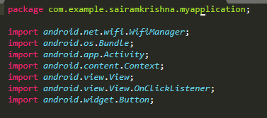
Slide 8
Code
6

Slide 7
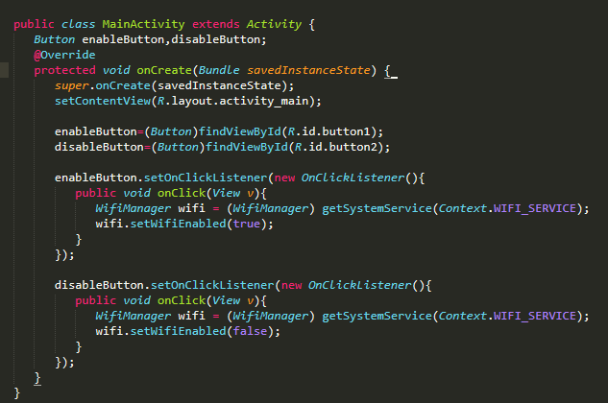
Code

Slide 8

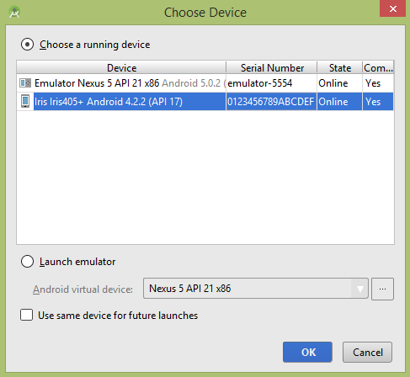
Run

Slide 9
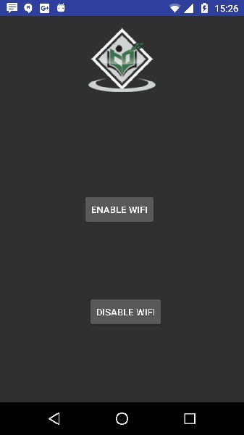
Run
Wi-Fi is open

Slide 10

Run
Wi-Fi is close

Slide 11

Slide 11
THANK YOU

